Slide 1
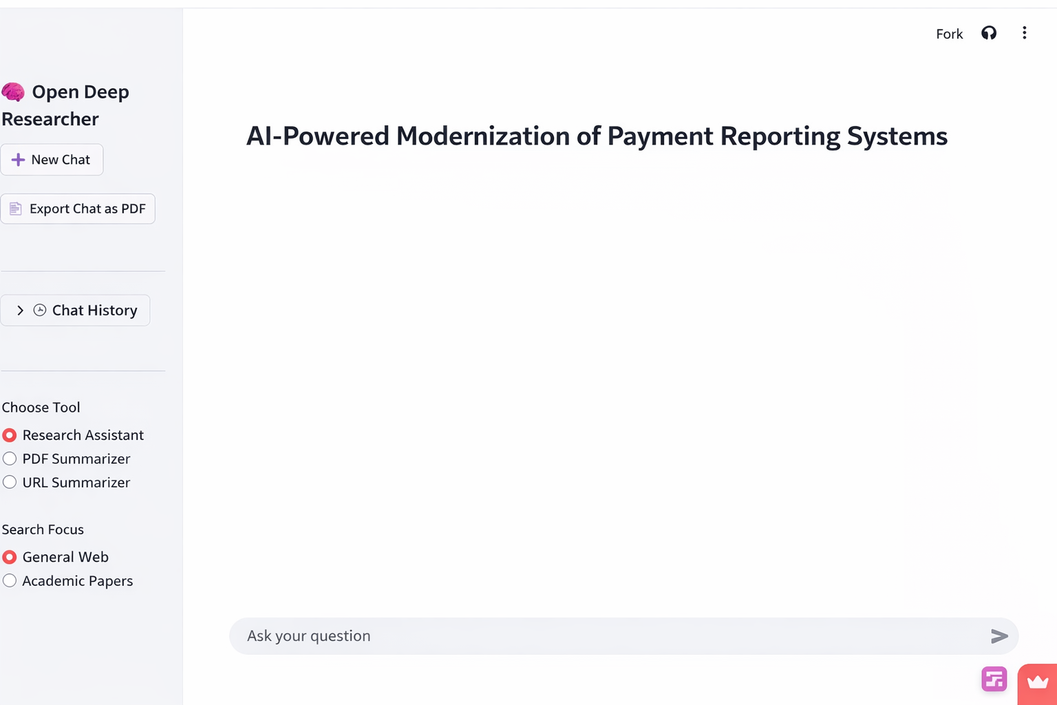
AI-Powered Modernization of Payment Reporting Systems
Transforming raw transaction data into intelligent, real-time
business insights through advanced machine
learning and automation

Slide 2
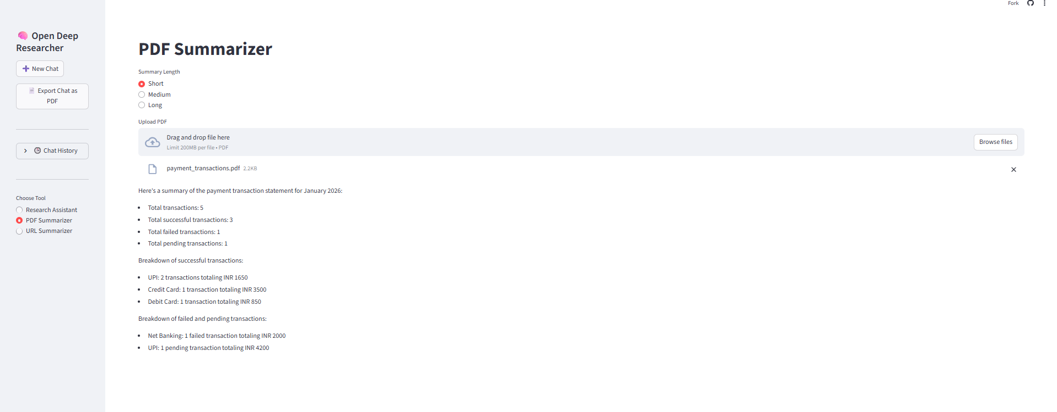
PROBLEM STATEMENT
Current Challenges in Payment Reporting
Traditional payment reporting systems are failing to meet the demands of modern fintech operations. Organizations struggle with manual processes, delayed insights, and mounting operational inefficiencies that directly impact decision-making speed and accuracy.
Manual & Delayed Processes
Unstructured Data Overload
Report generation requires hours or days, preventing timely responses to critical payment issues
Massive transaction volumes overwhelm existing systems, making analysis nearly impossible
Compliance & Audit Gaps
Difficult tracking and reconciliation create regulatory risks and audit challenges

Slide 3

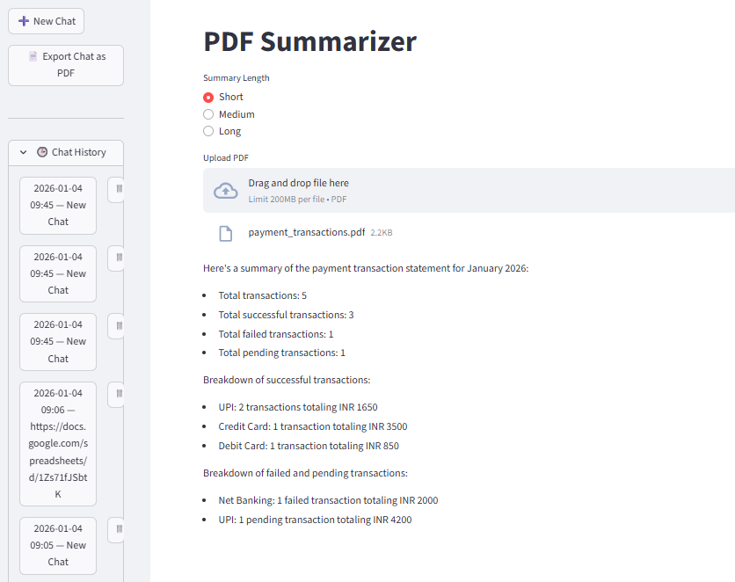



MARKET GAP
Why Modernization Is Essential Now
Limitations of Traditional Systems
Modern Business Requirements
Rule-based, non-adaptive processing
Zero predictive capabilities
Poor scalability with growing transaction volumes
Static reporting formats (CSV/PDF only)
Real-Time
No real-time visibility into payment flows
Instant insights
Intelligent
Predictive analytics
Automated
Zero manual work
Scalable
Handles billions

Slide 4
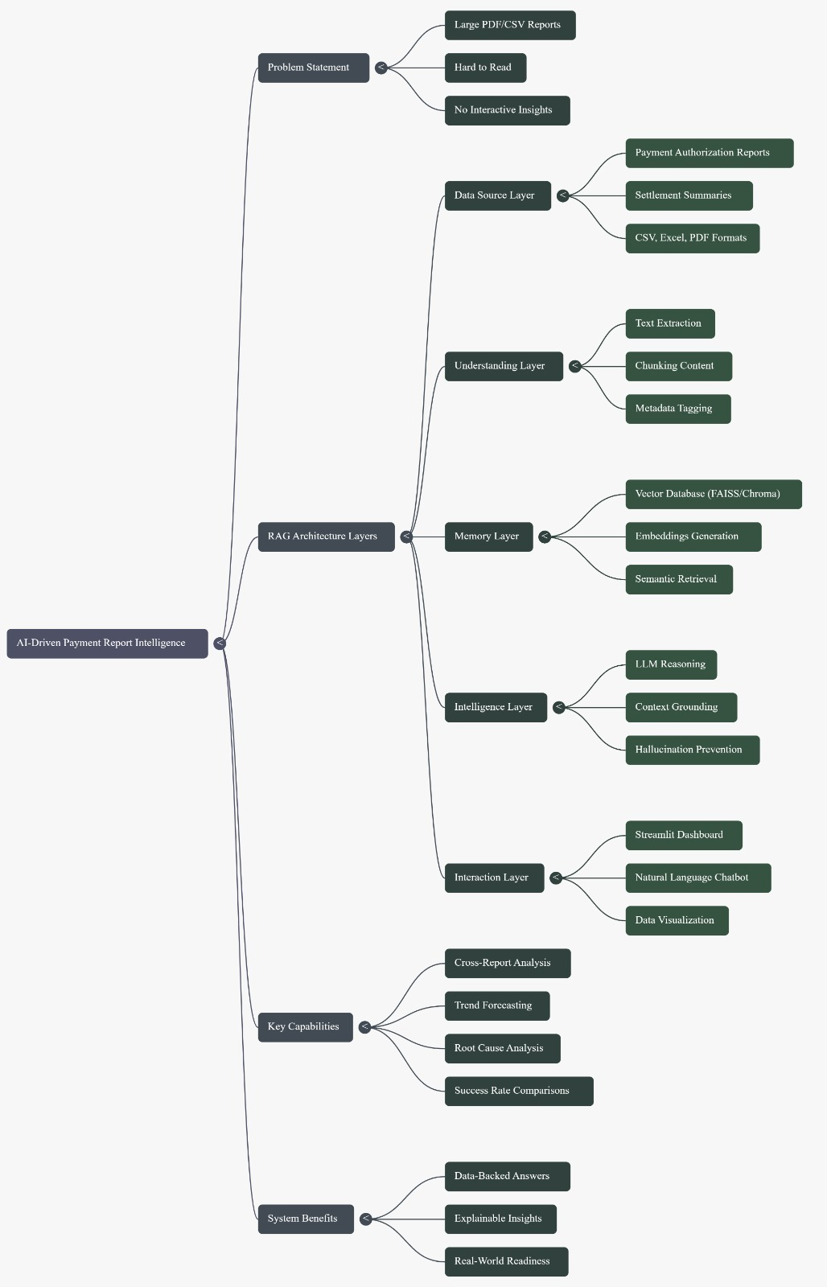





OUR SOLUTION
AI-Powered Payment Reporting Platform
We've built an intelligent system that uses advanced AI and machine learning to transform raw payment data into actionable business intelligence, delivering real-time insights that drive smarter financial decisions.
Ingest
Automatically collect transaction data from multiple sources
Analyze
AI models detect patterns, anomalies, and trends in milliseconds
Generate
Create intelligent, natural language reports with visual insights
Alert
Proactively notify stakeholders of critical events and predictions

Slide 5
TECHNICAL ARCHITECTURE
System Architecture Overview
01
02
03
Payment Data Sources
Data Ingestion Layer
AI/ML Processing Engine
Banks, UPI, credit cards, digital wallets, and payment gateways stream transaction data in real-time
Scalable ingestion pipeline handles millions of transactions per second with data validation and normalization
Advanced machine learning models classify, analyze, and extract insights from transaction patterns
04
05
Reporting & Analytics Dashboard
Export & Alert System
Interactive visualization platform with natural language querying and customizable report generation
Automated distribution of reports via PDF, CSV, email, and API with intelligent alerting

Slide 6





AI TECHNOLOGY
AI & Machine Learning Components
Transaction Classification
Supervised learning models automatically categorize payments by type, merchant, and purpose with 98%+ accuracy
Anomaly Detection
Unsupervised algorithms identify fraud patterns, duplicate payments, and unusual transaction behaviors in real-time
Trend Analysis
Time-series models reveal payment patterns, seasonal variations, and emerging trends across all channels
Predictive Forecasting
Advanced regression models predict future cash flows, payment volumes, and potential risk exposure
NLP Summarization
Natural language processing generates human-readable summaries and enables conversational report queries
Our platform leverages multiple AI techniques to deliver comprehensive payment intelligence, from transaction classification to predictive forecasting.

Slide 7

KEY FEATURES
Smart Reporting Capabilities
Auto-Generated Reports
Natural Language Summaries
Visual Dashboards
Conversational Queries
Dynamic charts, graphs, and heat maps reveal payment trends at a glance
Daily, weekly, and monthly reports created automatically with zero manual intervention
Plain English explanations of complex transaction data and insights
Ask questions in plain language: "Show failed payments last week" or "Which merchant had the highest refund rate?"

Slide 8
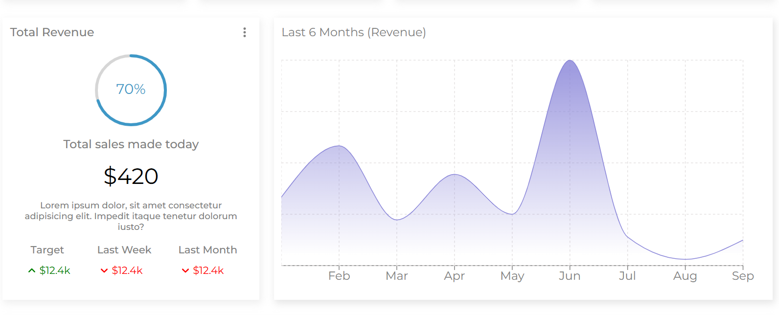
SECURITY & COMPLIANCE
Enterprise-Grade Security
Built-In Security Measures
End-to-End Encryption
AES-256 encryption for data at rest and TLS 1.3 for data in transit
Role-Based Access Control
Granular permissions ensure users only see authorized transaction data
Comprehensive Audit Logs
Immutable logs track every data access, modification, and report generation
Regulatory Compliance
Built-in compliance with PCI-DSS, SOC 2, GDPR, and financial industry standards
AI-Enhanced Security
Our machine learning models continuously monitor for fraudulent patterns, providing early detection that reduces financial risk by up to 85% compared to traditional rule-based systems.

Slide 9
BUSINESS IMPACT
Measurable Business Benefits
95%
87%
$2.4M
Faster Reporting
Error Reduction
Annual Savings
Real-time insights replace hours-long manual report generation
AI-powered validation eliminates human error in data analysis
Reduced operational costs and fraud losses per mid-size institution
10x
Faster Decisions
Executives make critical financial decisions in minutes, not days
Use Cases
Real-World Applications
Tech Stack
Banks & financial institutions
Detect unusual payment spikes indicating fraud, identify failed transaction patterns for system improvements, and forecast cash flow with 92% accuracy.
Frontend: React Dashboard
Backend: Node.js, Python
AI/ML: TensorFlow, Scikit-learn
Cloud: AWS/GCP
FinTech companies
E-commerce platforms
High-volume payment processors

Slide 10
NEXT STEPS
Thank You
Questions?
We're transforming payment reporting from static spreadsheets to intelligent, real-time business intelligence. Our AI-powered platform reduces manual work, enables data-driven decisions, and delivers a future-ready financial reporting system that scales with your growth.
Future Roadmap
Ready for Demo
Voice-based report queries
Experience our live platform processing real transaction data, generating intelligent reports, and detecting anomalies in real-time.
Blockchain audit transparency
Advanced fraud prediction
Multi-language support

